Slide 1


Simulate vehicle-to-vehicle (V2V) and vehicle-to-infrastructure (V2I) using 5G communication and latency analysis.
Review-2
AY 2025-26
Capstone Project – Introduction (PROJ2999)
GITAM (Deemed-to-be) University
Department of Electrical Electronics and Communication Engineering
Project Team:
SOMANATH K
C BHAVANI SHANKAR
SAITEJA K
Project Mentor:
Dr. T Nagarjuna
Project In-charge:
Dr. Kshitij Shakya
www.gitam.edu

Slide 2
Objective and Goals
Objective
The main objective of this project is to simulate Vehicle-to-Vehicle (V2V) and Vehicle-to-Infrastructure (V2I) communication using 5G technology and to analyze the latency performance in different scenarios.
The project aims to study how 5G enables reliable, high-speed, and ultra-low latency communication, which is essential for safety-critical applications such as collision avoidance, traffic management, and autonomous driving.
Goals
Main Goals
Analyze latency in different traffic conditions.
Demonstrate real-time data exchange for safety using MATLAB simulation

Slide 3
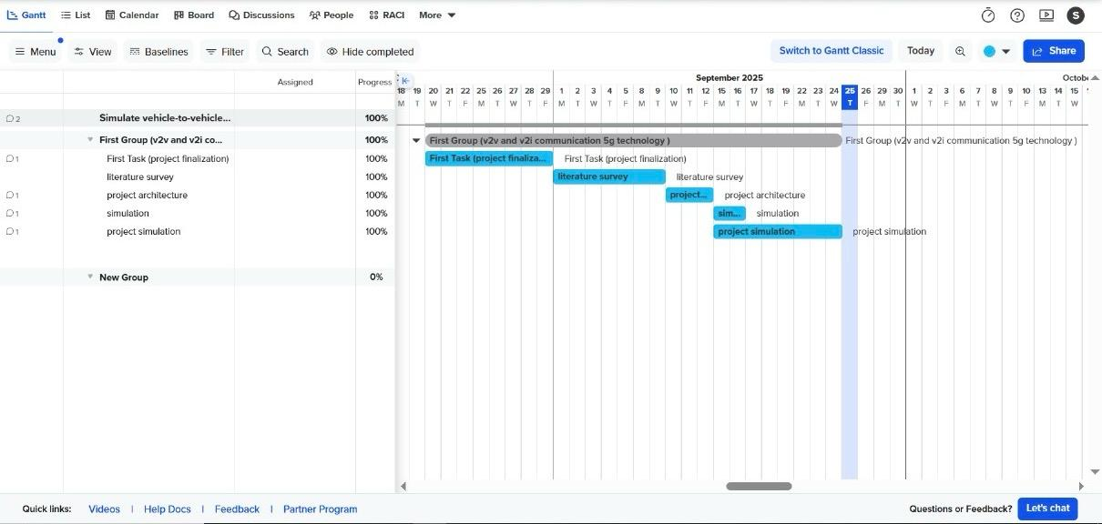
Project Plan (Clearly mention milestone for objectives under each reviews)
Gant Chart - Milestones and Activities
high-level phases(ordered):
1. Project setup & scenario definition
2.Vehicle model initialization & mobility simulation
3.5G communication system configuration (baseline)
4.Baseline V2V message exchange (conventional RF)
5.5G-enabled V2V simulation
6.Sensor fusion and radar integration
7.Evaluation & results analysis
8.Final deliverables, documentation & demo

Slide 4
literature survey
Author details | Research contribution | Research Limitations
Tahir, Muhammad Naeem, Pekka Leviäkangas, and Marcos Katz. "Connected vehicles: V2V and V2I road weather and traffic communication using cellular technologies." Sensors 22.3 (2022): 1142. | The study provides pilot field measurement results comparing LTE and 5G Test Network (5GTN) performance for vehicle-to-vehicle (V2V) and vehicle-to-infrastructure (V2I) communication. It shows that 5GTN significantly outperforms LTE in terms of bandwidth, throughput, packet loss, and latency while transmitting safety-critical road weather and traffic data. | The field measurements were conducted only on a single test track at the Finnish Meteorological Institute (FMI). This limited the diversity of road conditions, traffic density, and real-world variability, which may affect the generalizability of the results.
Muhammad, Mujahid, and Ghazanfar Ali Safdar. "5G-based V2V broadcast communications: A security perspective." Array 11 (2021): 100084. | Comprehensive Review of 5G-V2V Security Needs: The paper analyzes how 3GPP 5G-V2V (PC5 interface) can support safety and non-safety applications, emphasizing the importance of low-latency and trustworthy message exchange in road hazard communication. | The work mainly provides a conceptual and literature-based review. No field tests or simulations are presented to measure the practical impact of proposed access-layer security solutions on latency, throughput, or reliability.

Slide 5
Key Publications
5G Vehicular Networks: A Survey | Provides a comprehensive overview of 5G-enabled vehicular communication, including V2V and V2I use cases, network architecture, and performance metrics like latency, reliability, and throughput.
Latency Analysis of 5G-Based V2V and V2I Communication | Focuses on latency performance evaluation in vehicular scenarios, presenting simulation and analytical models to study end-to-end delays.
5G Technologies for Intelligent Transportation Systems | Reviews the role of 5G in ITS, highlighting its advantages for traffic management, autonomous vehicles, and enhanced safety through low-latency communication.
Simulation of 5G Communication in Vehicular Networks | Explores MATLAB-based simulation of 5G-enabled V2V and V2I communication, analyzing latency and throughput under different mobility and channel conditions.

Slide 6
Key Publications
Key Resources – Whitepaper| Application Notes | Datasheet| Others
MathWorks Whitepaper on 5G Toolbox: Explains how MATLAB can simulate 5G NR systems, including URLLC for V2X applications.
Qualcomm 5G Latency Analysis Whitepaper: Provides insights into low-latency communication for vehicular safety systems.
Existing Implementations – Products| Opensource| GitHub etc
MATLAB 5G Toolbox – For designing and simulating 5G NR V2V and V2I communication.
Communications Toolbox-
V2V wireless simulation, pathloss, SINR, PER, HARQ modeling
Statistics & Machine Learning Toolbox-
Rayleigh fading, random noise, percentiles, distance calculations
Parallel Computing Toolbox-
Multi-run Monte-Carlo speedup

Slide 7
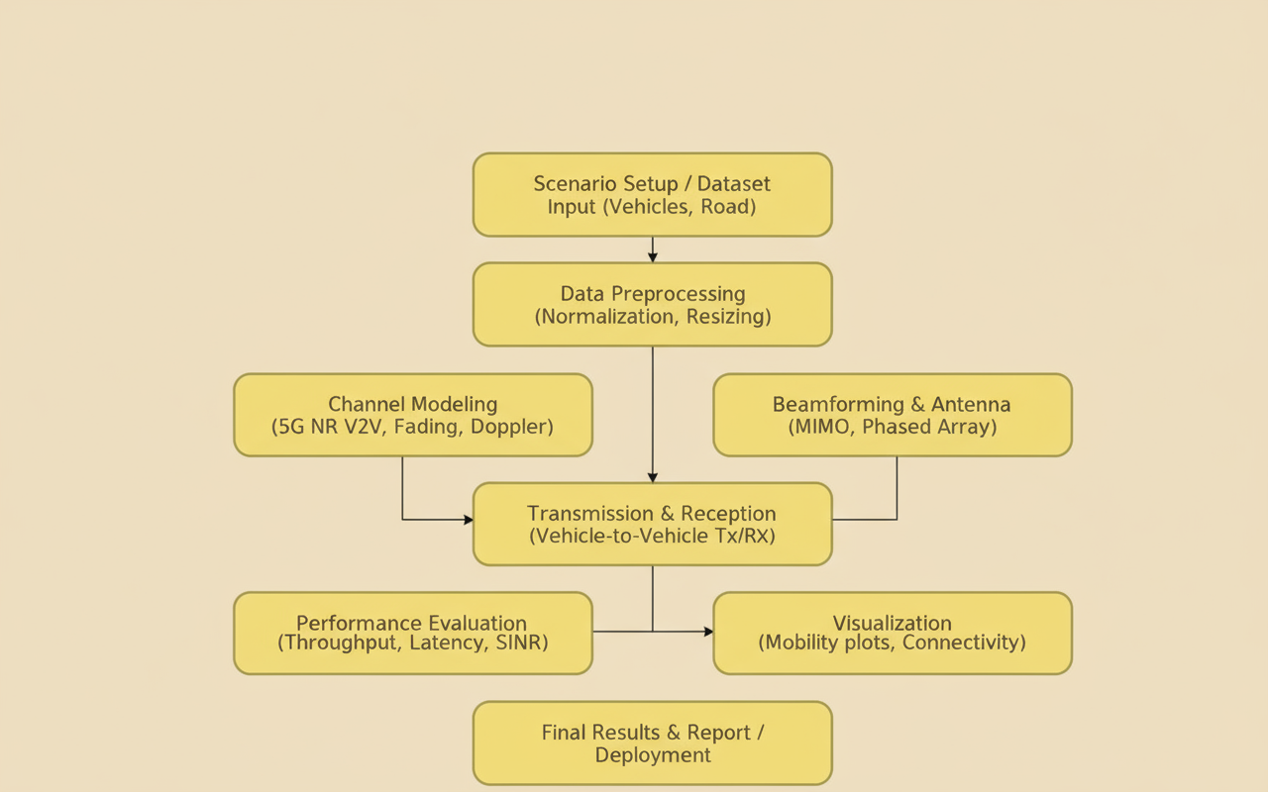
Architecture

Slide 8
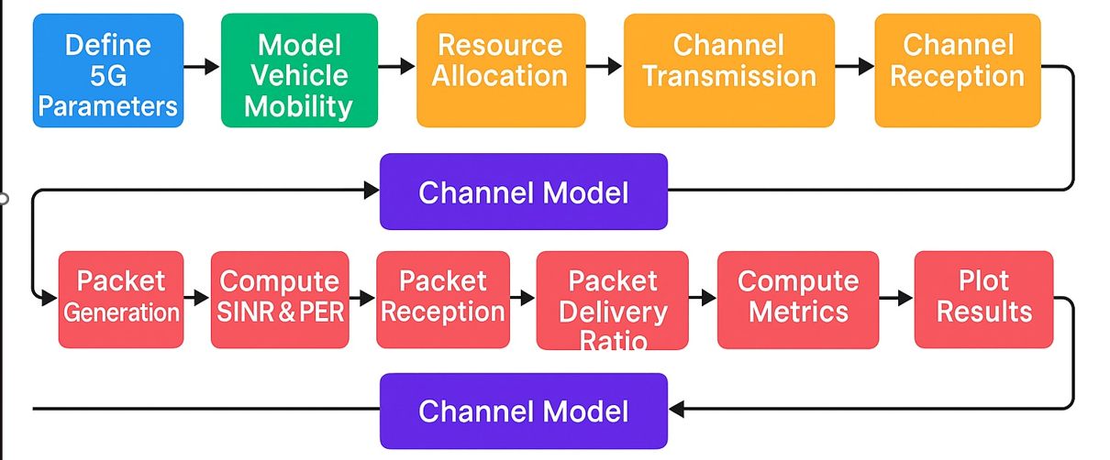
WORKFLOW

Slide 9
Use Cases
Use Cases
TC-01:
Simulation Setup → MATLAB 5G Toolbox loaded, network parameters initialized successfully.
TC-02:
Vehicle Mobility → Vehicle positions update correctly using MATLAB Vehicle Dynamics Blockset.
TC-03:
V2V Communication → MATLAB simulation shows messages transmitted between vehicles, packet loss < 5%.
TC-04:
V2I Communication → Vehicles connected successfully to simulated infrastructure (RSU/base station) in MATLAB.
TC-05:
Latency Measurement → End-to-end latency calculated using MATLAB functions ≤ 10 ms for safety messages.
TC-06:
Throughput Calculation → MATLAB computes throughput ≥ 95% of configured 5G bandwidth.
TC-07:
Reliability Testing → MATLAB simulation shows packet delivery ratio ≥ 90% under different traffic densities.
TC-08:
Visualization → MATLAB plots display vehicle positions and communication links clearly.

Slide 10
Test Cases
Test Cases
TC-01: Latency Calculation
→ MATLAB computes accurate end-to-end latency for all V2V packets.
TC-02: Latency Matrix
→ MATLAB generates correct vehicle-to-vehicle latency matrix with valid values.
TC-03: Power Delivery Ratio (PDR)
→ MATLAB calculates correct PDR based on received signal power levels.
TC-04: Mean Latency per Vehicle
→ MATLAB outputs correct average latency values for each vehicle.
TC-05: Heat Matrix
→ MATLAB generates correct heatmap for latency/SNR/performance without missing data.
TC-06: Safety Risk Matrix
→ MATLAB produces accurate risk matrix using latency, distance, and reliability metrics.
TC-07: Scenario Variation
→ MATLAB updates all performance metrics correctly across urban/highway/dense-traffic scenarios.

Slide 11
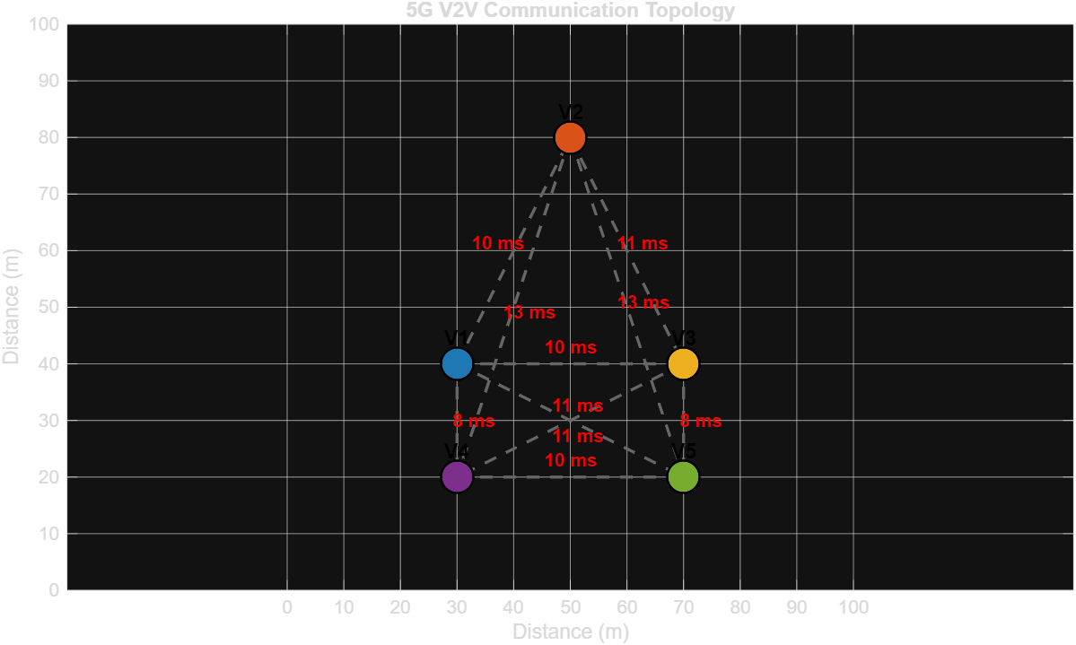
Implementation and Results – Iteration 1
Iteration 1 : Results
5G V2V COMMUNICATION TOPOLOGY

Slide 12
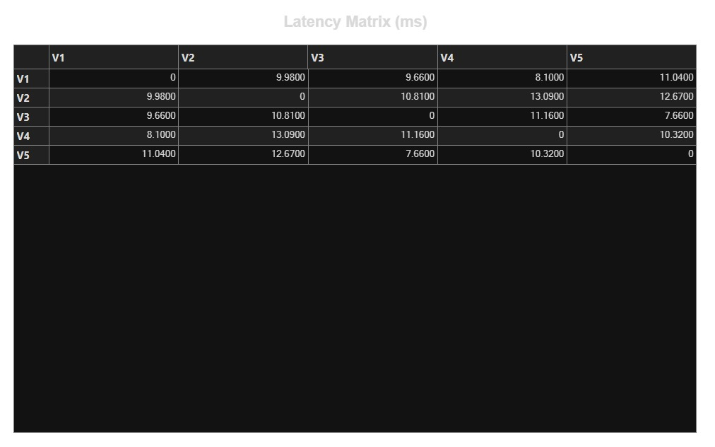
Implementation and Results – Iteration 2
Iteration 2 : Results
LATENCY MATRIX

Slide 13
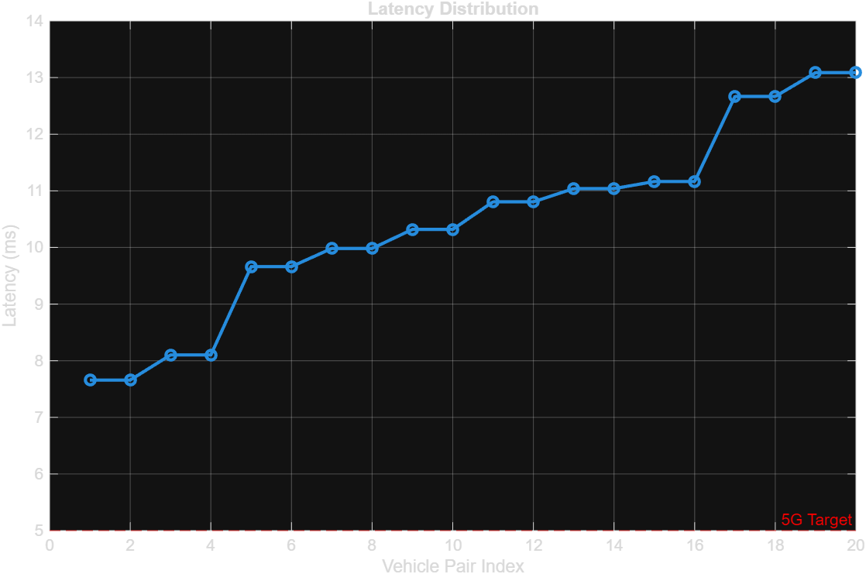
Implementation and Results – Iteration 3
Iteration 3 : Results
LATENCY DISTRIBUTION

Slide 14
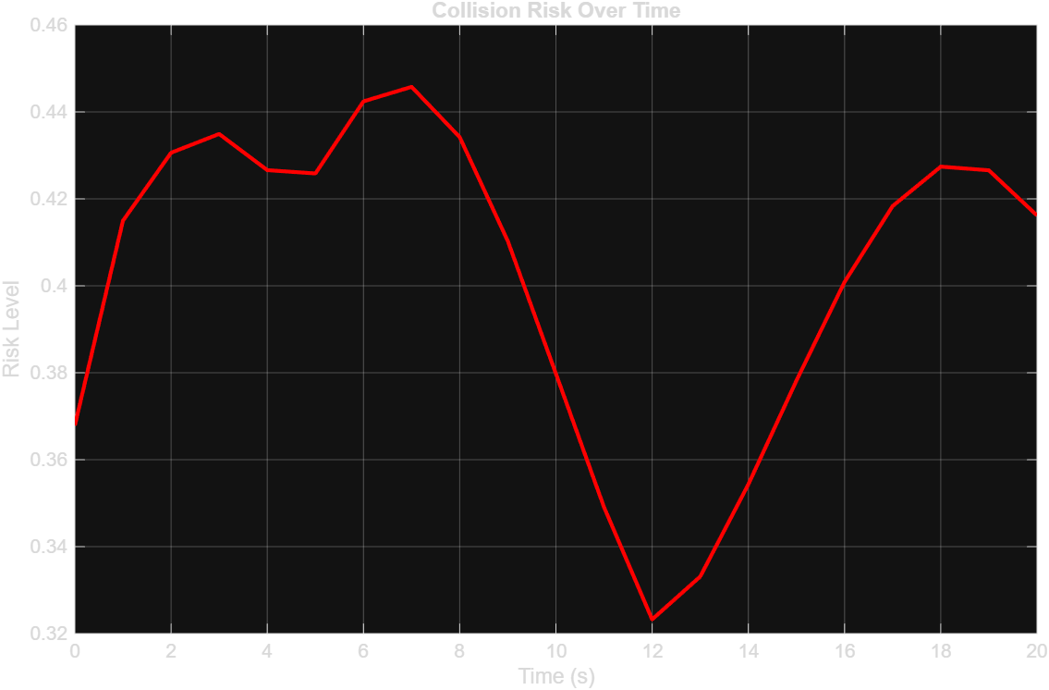
Implementation and Results – Iteration 4
Iteration 4 : Results
COLLISION RISK OVER TIME

Slide 15
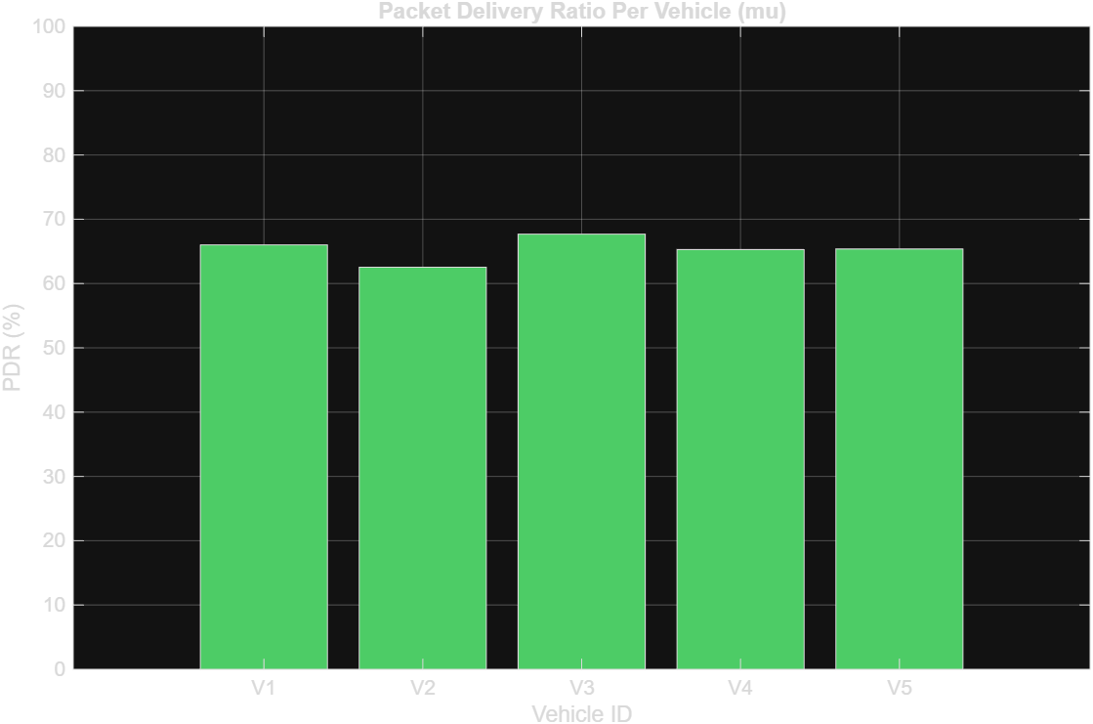
Implementation and Results – Iteration 5
Iteration 5 : Results
PDR PER VEHICLE

Slide 16
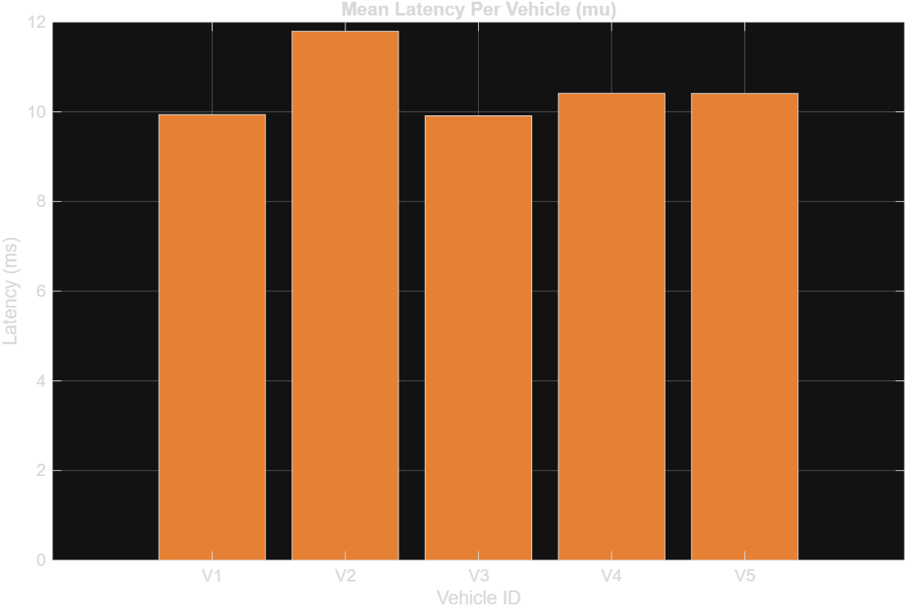
Implementation and Results – Iteration 6
Iteration 6 : Results
MEAN LATENCY PER VEHICLE

Slide 17
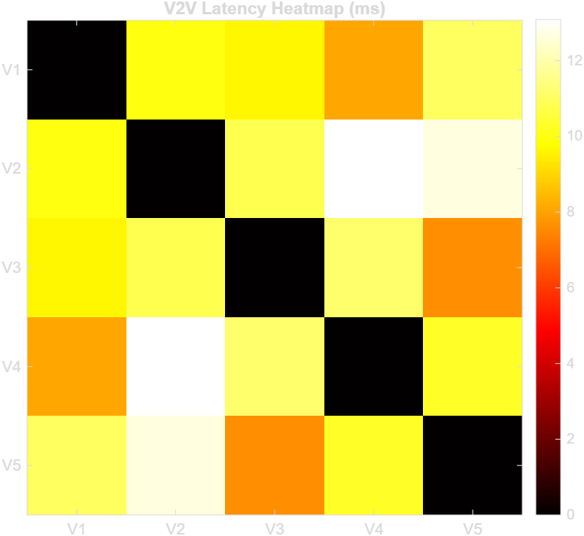
Implementation and Results – Iteration 7
Iteration 7 : Results
LATENCY HEATMAP

Slide 18
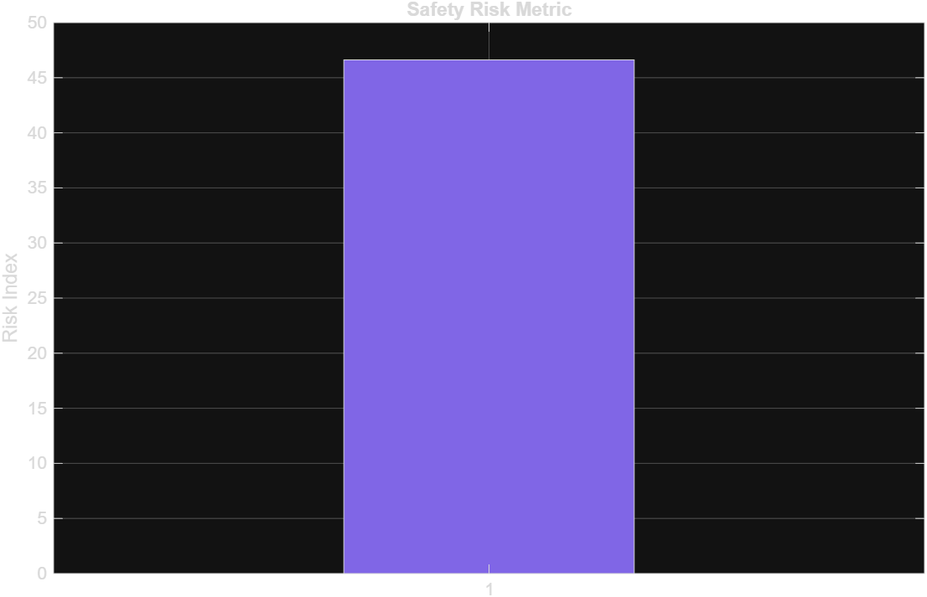
Implementation and Results – Iteration 8
Iteration 8 : Results
SAFETY RISK METRICS

Slide 19
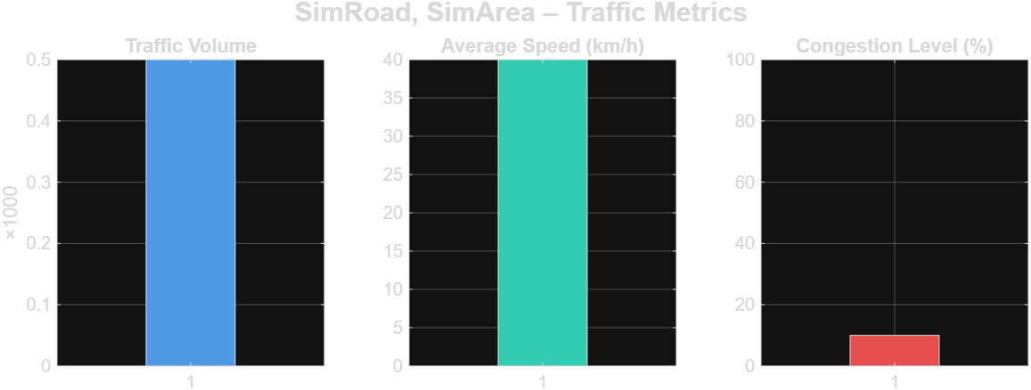
Implementation and Results – Iteration 9
Iteration : Results + Validation against the use cases and test cases
TRAFFIC VOLUME AVERAGE SPEED(KM/H) CONGESTION LEVEL(%)

Slide 20
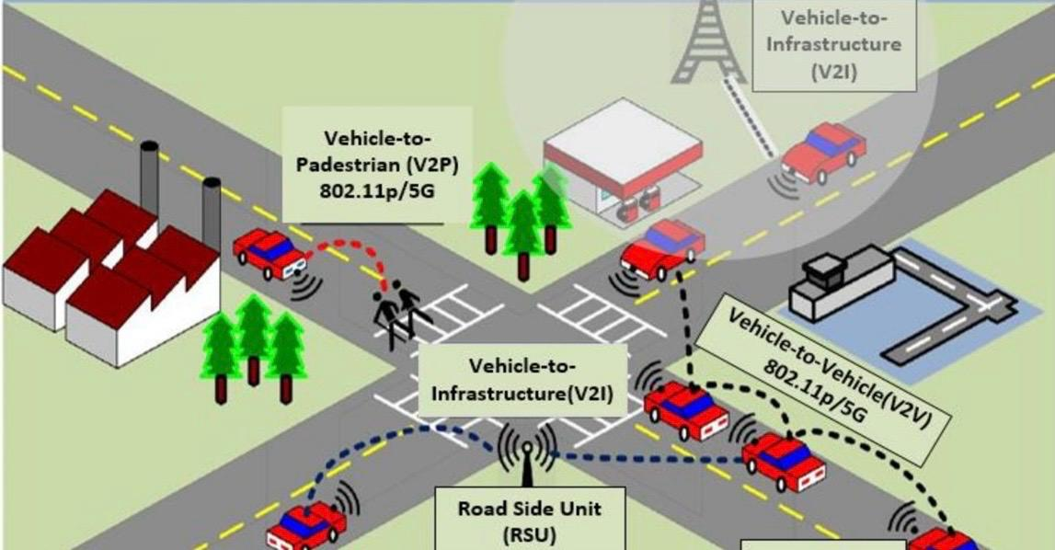
V2V & V2I Architecture Applications

Slide 21
CONCLUSION:
Vehicle-to-vehicle (V2V) communication using 5G enables ultra-low latency, high bandwidth, and highly reliable data exchange between connected vehicles. This empowers real-time safety applications—such as collision avoidance and cooperative adaptive cruise control—and supports autonomous driving by ensuring vehicles can instantly share and respond to road, traffic, and hazard information. 5G’s high capacity and seamless connectivity also enhance driving accuracy, road safety, and overall transportation efficiency, representing a major advancement over previous wireless technologies.

Slide 22
Future Work – V2I Communication Using 5G
• Deployment of 5G-Enabled Roadside Units (RSUs)
Enable real-time traffic alerts, hazard warnings, and seamless vehicle–infrastructure connectivity.
• Integration of MEC (Edge Computing)
Use edge servers near RSUs for ultra-low latency tasks such as cooperative perception and traffic prediction.
• Beamforming for High-Speed V2I
Explore 28/60 GHz links to support high-data-rate services like HD map updates and sensor sharing.
• AI-Based Resource Allocation & Congestion Prediction
Apply machine learning to optimize RB allocation, reduce interference, and improve V2I communication stability.
• Enhanced Security & Authentication
Study 5G security features to protect V2I links from spoofing, jamming, and unauthorized access.

Slide 23
References
[1] 3GPP TR 22.886 (V16.2.0)
“Study on enhancement of 3GPP Support for 5G V2X Services.”
3rd Generation Partnership Project, 2018.
(Defines 5G NR V2X features, sidelink, latency, reliability.)
[2] 3GPP TS 38.300 (V16 Series)
“NR; Overall description; Stage-2.”
3GPP, 2020.
(Core specifications for 5G NR physical layer, numerology, slots.)
[3] Shanzhi Chen, Jing Zhao, et al.
“A Vision of C-V2X: Technologies, Field Testing, and Challenges.”
IEEE Internet of Things Journal, 2020.
(Explains V2V/V2I over cellular networks including 5G and sidelink.)
[4] H. Seo, K. Lee, et al.
“LTE Evolution for Vehicle-to-Everything (V2X) Services.”
IEEE Communications Magazine, 2016.
(Foundation of V2X architecture; used as baseline before 5G NR.)
[5] 5G Automotive Association (5GAA)
“Toward Fully Connected Vehicles: 5G-V2X.”
5GAA White Paper, 2019.
(Explains 5G-based V2V/V2I ecosystem and real-world deployment

Slide 24
THANK YOU
Have a Great Day !

